Slide 1

Risk Management Strategy
Confidential
Created by ex-McKinsey, Deloitte & BCG Management Consultants

Slide 2







This deliverable will focus on the phase I of our 7-phase Risk Management Approach
1.Risk Management Strategy & Plan
2.Risk Identification
3.Risk Assessment
4.Risk Prioritization
5.Risk Mitigation
6.Risk Closure and Issue Escalation
7. Issue Management

Slide 3
Introduction
You can directly use this deliverable for your own purposes. You’ll simply have to insert your logo and adjust the slides based on the specificities of your organization.
Please note that this document also includes many slides with best practices, tutorials, and real-life examples to help you adjust this deliverable based on the specificities of your organization. These slides includes an orange rectangle on their top right corner. You may decide to delete these slides as they are mainly here to help you fill in the rest of the deliverable. Before you do so, copy paste this document, so you always have the original version in case you need it.

Slide 4
Table of contents
1.Risk Management Strategy & Plan
2.Risk Identification
3.Risk Assessment
4.Risk Prioritization
5.Risk Mitigation
6.Risk Closure and Issue Escalation
7. Issue Management
Summary of the corporate and business strategy
Risk appetite
Risk management capability maturity model
Risk management mission, vision and strategic objectives
Risk management KPIs, targets and initiatives
Roadmap to reach our strategic objectives
Risk management team and budget
Governance structure
Guiding principles
Framework to manage risk
Risk types and examples
Tools to identify risks
Simple risk log in Powerpoint
Comprehensive risk log in Excel
Probability of the risk to happen
Potential impact of the risk
Risk value
3 by 3 risk prioritization matrix in Powerpoint and Excel
5 by 5 risk prioritization matrix in Powerpoint and Excel
Response options
Examples
Actions, deadlines and responsibilities
Dashboard
Risk closure
Issue escalation
Simple issue log in Powerpoint
Comprehensive issue log in Excel

Slide 5
Table of contents
1.Risk Management Strategy & Plan
2.Risk Identification
3.Risk Assessment
4.Risk Prioritization
5.Risk Mitigation
6.Risk Closure and Issue Escalation
7. Issue Management
Summary of the corporate and business strategy
Risk appetite
Risk management capability maturity model
Risk management mission, vision and strategic objectives
Risk management KPIs, targets and initiatives
Roadmap to reach our strategic objectives
Risk management team and budget
Governance structure
Guiding principles
Framework to manage risk
Risk types and examples
Tools to identify risks
Simple risk log in Powerpoint
Comprehensive risk log in Excel
Probability of the risk to happen
Potential impact of the risk
Risk value
3 by 3 risk prioritization matrix in Powerpoint and Excel
5 by 5 risk prioritization matrix in Powerpoint and Excel
Response options
Examples
Actions, deadlines and responsibilities
Dashboard
Risk closure
Issue escalation
Simple issue log in Powerpoint
Comprehensive issue log in Excel

Slide 6
Mission statement, vision statement and values
Mission Statement
Vision Statement
Insert your own text
Insert your own text
Insert value
Insert value
Insert value
Insert value
Insert value

Slide 7
Mission statement, vision statement and values
Tutorial
Mission Statement
Vision Statement
It is the company’s reason for existence or purpose.
It describes the overarching intent of the organization.
It is usually defined during a workshop with the top management.
It should provide focus, direction and help guide decision making and actions.
It should be one easy to understand sentence and, if required, a more details description below the main sentence.
It describes the organization desired or intended state at some point in the near or distant future.
It describes the overarching aim of the organization as it progresses into the future.
Like the Mission Statement, it is usually defined during a workshop with the top management.
It should provide focus, direction and help guide decision making and actions.
It should be one easy to understand sentence and, if required, a more details description below the main sentence.
Insert value
Insert value
Insert value
Insert value
Insert value
Company values (also called corporate values or core values) are the set of guiding principles and fundamental beliefs that help a group of people function together as a team and work toward a common business goal. These values are often related to business relationships, customer relationships, and company growth. Company values don’t have to be unique; they should be what your company wants to see in itself and its employees. Some examples are “Integrity”, “Trust”, “Accountability”, “Respect” or “Value-centricity

Slide 8
Strategy Map
Perspective
Strategic objectives
Financial
Insert your own text
Insert your own text
Insert your own text
Insert your own text
Insert your own text
Insert your own text
Insert your own text
Customer
Insert your own text
Insert your own text
Insert your own text
Internal Process
Insert your own text
Insert your own text
Insert your own text
Insert your own text
Learning
& Growth
Insert your own text
Insert your own text
Insert your own text
Insert your own text

Slide 9
Strategy Map Purpose
Tutorial
The Strategy Map provides an overview of all the Strategic Objectives that need to be reached in order to achieve the company’s Mission and Vision.
It also provides a better understanding of the Cause-Effect relationships between the different Strategic Objectives.

Slide 10
Strategy Map A Strategy map includes 4 perspectives
Tutorial
Perspectives
Financial
Presents the strategic objectives driving financial performance
Customer
Presents the strategic objectives related to the value proposition of the company
Internal Process
Presents the strategic objectives related to the internal capabilities of the company
Learning
& Growth
Presents the strategic objectives related to the intangible assets required to drive performance

Slide 11
Strategy Map There is a cause-and-effect logic between each perspective
Tutorial
Financial
Shareholder Value
Customer
Internal process
Learning
& Growth

Slide 12
Strategy Map How to identify your strategic objectives in 6 questions?
Tutorial
Perspective
Questions
Financial
To satisfy our shareholders, what financial objectives must we accomplish?
To reflect our Mission statement, which Strategic objectives must we reach?
To achieve our Vision statement, which Strategic objectives must we reach?
Customer
To achieve our financial objectives, what customer needs must we serve?
Internal Process
To satisfy our customers and shareholders, in which internal business processes must we excel?
Learning
& Growth
To achieve our “Financial”, “Customer” and “Internal Processes” strategic objectives, what does the organization need to learn?

Slide 13
Strategy Map
Please note that usually, Fortune 500 companies use the 4 perspectives described in this slide, which were initially introduced by the famous Strategists Norton and Kaplan. However, you may decide to use different perspectives. For example, many of our clients use 4 stakeholder groups such as: Shareholders, Customers, Employees and Communities.
Tutorial
Perspective
Strategic objectives
Financial
Insert your own text
Insert your own text
Insert your own text
Insert your own text
Insert your own text
Insert your own text
Insert your own text
Customer
Insert your own text
Insert your own text
Insert your own text
Internal Process
Insert your own text
Insert your own text
Insert your own text
Insert your own text
Learning
& Growth
Insert your own text
Insert your own text
Insert your own text
Insert your own text

Slide 14
Strategy Map Example of a Strategy Map
Real-life example
Perspective
Strategic objectives
Financial
Increase profit
Increase revenue
Decrease Cost
Increase number of customers
Increase revenue per customer
Decrease fixed cost
Decrease variable cost
Customer
Increase customer satisfaction
Become a trusted brand
Sell new products
Internal Process
Understand customer segments
Shift to digital channel
Decrease delivery time
Create new products
Learning
& Growth
Improve
employee satisfaction
Improve customer information
Create a customer-focused culture
Align the organization
Caption:
Significantly behind target
Slightly behind target
Meeting target or above target

Slide 15
Strategy Map Example of a Strategy Map with explicit relationships between the top strategic objectives
Real-life example
Perspective
Strategic objectives
Financial
Increase profit
Increase revenue
Decrease Cost
Increase number of customers
Increase revenue per customer
Decrease fixed cost
Decrease variable cost
Customer
Increase customer satisfaction
Become a trusted brand
Sell new products
Internal Process
Understand customer segments
Shift to digital channel
Decrease delivery time
Create new products
Learning
& Growth
Improve
employee satisfaction
Improve customer information
Create a customer-focused culture
Align the organization

Slide 16
Strategy Map Template #2
Additional template you may prefer to use
Financial Perspective
Insert your own text
Insert your own text
Insert your own text
Insert your own text
Customer Perspective
Insert your own text
Insert your own text
Insert your own text
Insert your own text
Internal
Perspective
Insert your own text
Insert your own text
Insert your own text
Insert your own text
Customer Management
Operations
Insert your own text
Insert your own text
Insert your own text
Insert your own text
Innovation
Insert your own text
Insert your own text
Insert your own text
Insert your own text
Learning & Growth Perspective
Human Capital
Insert your own text
Insert your own text
Insert your own text
Insert your own text
Information Capital
Insert your own text
Insert your own text
Insert your own text
Insert your own text
Organization Capital
Insert your own text
Insert your own text
Insert your own text
Insert your own text

Slide 17
Strategy Map Template #3
Additional template you may prefer to use
Financial Perspective
Insert your own text
Insert your own text
Insert your own text
Insert your own text
Insert your own text
Customer Perspective
Insert your own text
Insert your own text
Insert your own text
Insert your own text
Insert your own text
Internal Perspective
Insert your own text
Insert your own text
Insert your own text
Insert your own text
Insert your own text
Insert text
Insert text
Insert text
Insert text
Insert text
Insert text
Insert text
Insert text
Insert text
Insert text
Insert text
Insert text
Insert text
Insert text
Insert text
Learning & Growth Perspective
Insert your own text
Insert your own text
Insert your own text
Insert your own text
Insert your own text
Insert text
Insert text
Insert text
Insert text
Insert text
Insert text
Insert text
Insert text
Insert text
Insert text
Insert text
Insert text
Insert text
Insert text
Insert text

Slide 18
Balanced Scorecard Purpose
The Balanced Scorecard is a tool that helps organizations translate a Strategy into:
Strategic Objectives
Key Performance Indicators KPIs
Targets to be reached

Slide 19
Balanced Scorecard
Perspective
Strategic Objectives
Key Performance Indicators
Targets
Financial
F1 - Insert text
F2 - Insert text
F3 - Insert text
F4 - Insert text
F1 - Insert text
F2 - Insert text
F3 - Insert text
F4 - Insert text
F1 - Insert text
F2 - Insert text
F3 - Insert text
F4 - Insert text
Customer
C1 - Insert text
C2 - Insert text
C3 - Insert text
C4 - Insert text
C1 - Insert text
C2 - Insert text
C3 - Insert text
C4 - Insert text
C1 - Insert text
C2 - Insert text
C3 - Insert text
C4 - Insert text
Internal Process
I1 - Insert text
I2 - Insert text
I3 - Insert text
I4 - Insert text
I1 - Insert text
I2 - Insert text
I3 - Insert text
I4 - Insert text
I1 - Insert text
I2 - Insert text
I3 - Insert text
I4 - Insert text
Learning & Growth
L1 - Insert text
L2 - Insert text
L3 - Insert text
L4 - Insert text
L1 - Insert text
L2 - Insert text
L3 - Insert text
L4 - Insert text
L1 - Insert text
L2 - Insert text
L3 - Insert text
L4 - Insert text

Slide 20
Balanced Scorecard Description
Tutorial
A Balanced Scorecard includes 4 perspectives
Perspective
Strategic Objectives
Key Performance Indicators
Targets
Financial
To satisfy our shareholders, what financial objectives must we accomplish?
F1 - Insert text
F2 - Insert text
F3 - Insert text
F4 - Insert text
F1 - Insert text
F2 - Insert text
F3 - Insert text
F4 - Insert text
F1 - Insert text
F2 - Insert text
F3 - Insert text
F4 - Insert text
The perspectives you choose should be aligned with the perspective you selected for your strategy map. Each perspective has specific Strategic Objectives, Key Performance Indicators & Targets.
Customer
To achieve our financial objectives, what customer needs must we serve?
C1 - Insert text
C2 - Insert text
C3 - Insert text
C4 - Insert text
C1 - Insert text
C2 - Insert text
C3 - Insert text
C4 - Insert text
C1 - Insert text
C2 - Insert text
C3 - Insert text
C4 - Insert text
Internal processes
To satisfy our customers and shareholders, in which internal business processes must we excel?”
I1 - Insert text
I2 - Insert text
I3 - Insert text
I4 - Insert text
I1 - Insert text
I2 - Insert text
I3 - Insert text
I4 - Insert text
I1 - Insert text
I2 - Insert text
I3 - Insert text
I4 - Insert text
Learning & Growth
To achieve our “Financial”, “Customer” and “Internal Processes” strategic objectives, what does the organization need to learn?
L1 - Insert text
L2 - Insert text
L3 - Insert text
L4 - Insert text
L1 - Insert text
L2 - Insert text
L3 - Insert text
L4 - Insert text
L1 - Insert text
L2 - Insert text
L3 - Insert text
L4 - Insert text

Slide 21
Balanced Scorecard Description
Real-life example
Perspective
Strategic Objectives
Key Performance Indicators
Targets
Financial
To satisfy our shareholders, what financial objectives must we accomplish?
F1 Increase earnings per share
F2 Increase revenue per customer
F3 Reduce cost per customer
F1 Net income per share (vs. last year)
F2 Revenue per customer
F3 Cost per customer
F1 +$100M
F2 $300
F3 $75
Customer
To achieve our financial objectives, what customer needs must we serve?
C1 Insert your own text
C2 Insert your own text
C3 Insert your own text
C1 Insert your own text
C2 Insert your own text
C3 Insert your own text
C1 Insert figure
C2 Insert figure
C3 Insert figure
Internal processes
To satisfy our customers and shareholders, in which internal business processes must we excel?”
I1 Insert your own text
I2 Insert your own text
I3 Insert your own text
I1 Insert your own text
I2 Insert your own text
I3 Insert your own text
I1 Insert figure
I2 Insert figure
I3 Insert figure
Learning & Growth
To achieve our “Financial”, “Customer” and “Internal Processes” strategic objectives, what does the organization need to learn?
L1 Insert your own text
L2 Insert your own text
L3 Insert your own text
L1 Insert your own text
L2 Insert your own text
L3 Insert your own text
L1 Insert figure
L2 Insert figure
L3 Insert figure

Slide 22
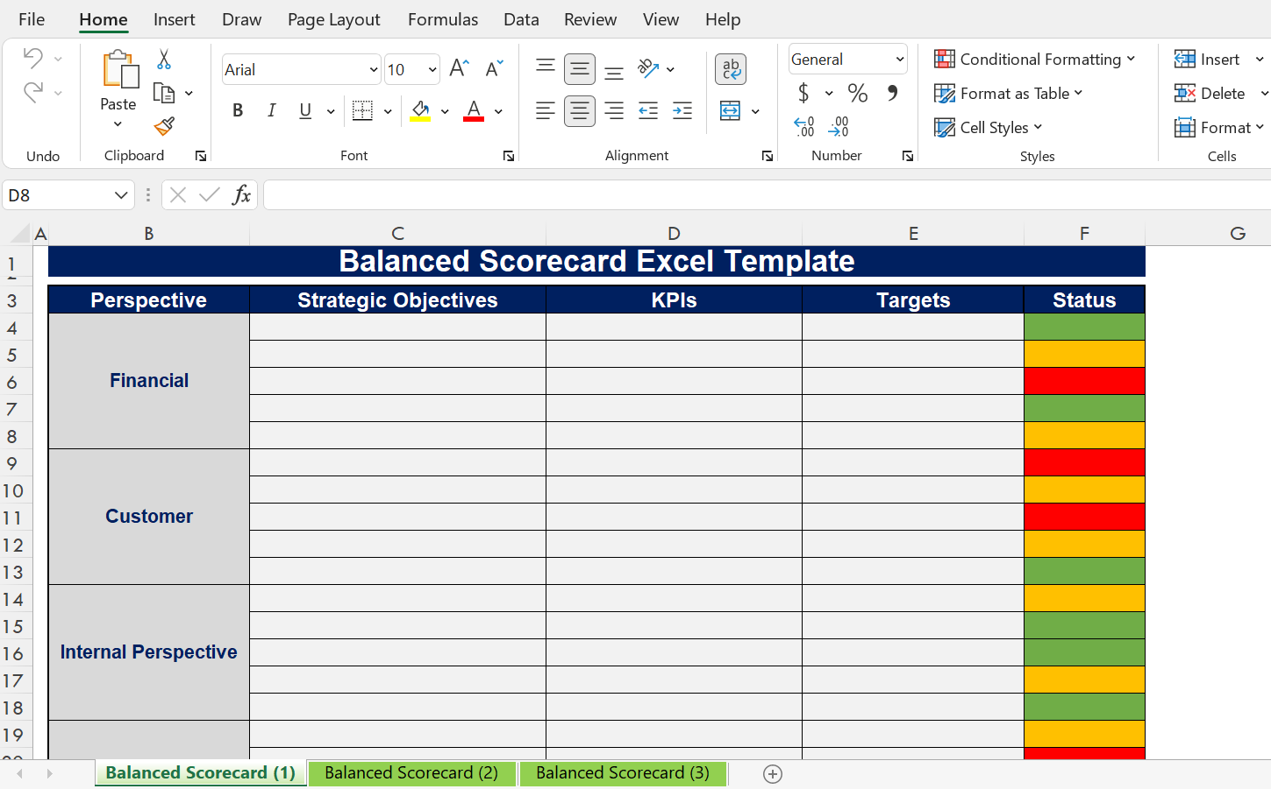
Balanced Scorecard Description
Additional templates in Excel
Open the Excel document “Balanced Scorecard” to access the templates

Slide 23
Table of contents
1.Risk Management Strategy & Plan
2.Risk Identification
3.Risk Assessment
4.Risk Prioritization
5.Risk Mitigation
6.Risk Closure and Issue Escalation
7. Issue Management
Summary of the corporate and business strategy
Risk appetite
Risk management capability maturity model
Risk management mission, vision and strategic objectives
Risk management KPIs, targets and initiatives
Roadmap to reach our strategic objectives
Risk management team and budget
Governance structure
Guiding principles
Framework to manage risk
Risk types and examples
Tools to identify risks
Simple risk log in Powerpoint
Comprehensive risk log in Excel
Probability of the risk to happen
Potential impact of the risk
Risk value
3 by 3 risk prioritization matrix in Powerpoint and Excel
5 by 5 risk prioritization matrix in Powerpoint and Excel
Response options
Examples
Actions, deadlines and responsibilities
Dashboard
Risk closure
Issue escalation
Simple issue log in Powerpoint
Comprehensive issue log in Excel

Slide 24
What do we mean by risk appetite?
Risk appetite is the amount of risk an entity is willing to accept or retain in order to achieve its objectives. It is a statement or series of statements that describes the entity’s attitude towards risk taking. Determining an entity’s risk appetite occurs through the development of risk appetite statements which clearly set out what the executive consider to be acceptable risk-taking. Risk appetite statements are usually aligned to categories of risk (e.g. financial, people and reputation risks).
Risk appetite statements will look and feel different according to an entity’s internal and external context. If these are not calibrated, the resultant actions may be skewed either too lightly (e.g. no action
required) or result in an over-controlled risk response.
To help us assess our organization’s risk appetite, we decided to use a risk appetite scale (see next slide).

Slide 25
What are the benefits of defining risk appetite?
Supporting conscious and informed risk taking
Promoting a more consistent risk management approach
Guiding risk decision making
Structuring the executive conversation on risk taking
Calibrating the organization risk assessment process

Slide 26
Risk appetite scale
1 - Very low appetite
2 - Low appetite
2 - Moderate appetite
4 - High appetite
5 - Very high appetite
Insert your own text
Insert your own definition
Insert your own definition
Insert your own definition
Insert your own definition
Insert your own definition
Insert your own text
Insert your own definition
Insert your own definition
Insert your own definition
Insert your own definition
Insert your own definition
Insert your own text
Insert your own definition
Insert your own definition
Insert your own definition
Insert your own definition
Insert your own definition
Insert your own text
Insert your own definition
Insert your own definition
Insert your own definition
Insert your own definition
Insert your own definition

Slide 27
Risk appetite scale
Real-life example from Fortune 500 company
1 - Very low appetite
2 - Low appetite
2 - Moderate appetite
4 - High appetite
5 - Very high appetite
Risk taking
The organization takes caution and often accepts as little risk as possible
The organization takes a cautious approach towards taking risk
The organization takes a balanced approach to risk taking
The organization is willing to take greater than normal risks
The organization believes aggressive risk taking is justified
Choice when faced with multiple options
Will select the lowest risk option, always
Will accept only if essential, and limited possibility/extent of failure
Will accept if limited, and heavily out-weighted by benefits
Will choose to put at risk, but will manage impact
Will choose option with highest return; accept possibility of failure
Objective / negative impact relationship
Not willing to accept any potential negative impact in order to pursue strategic objectives
Only willing to accept a small potential negative impact in order to pursue strategic objectives
Potential negative impact and the completion of strategic objectives are given equal considerations
Willing to accept some potential negative impact in order to pursue strategic objectives
Willing to accept a potential large negative impact in order to pursue strategic objectives
Tolerance for uncertainty
Very low
Low
Limited
Expect some
Fully anticipated

Slide 28
Following multiple interviews and workshops, we assessed that the risk appetite of our organization was high [insert your own rating
1 - Very low appetite
2 - Low appetite
2 - Moderate appetite
4 - High appetite
5 - Very high appetite
Risk taking
The organization takes caution and often accepts as little risk as possible
The organization takes a cautious approach towards taking risk
The organization takes a balanced approach to risk taking
The organization is willing to take greater than normal risks
The organization believes aggressive risk taking is justified
Choice when faced with multiple options
Will select the lowest risk option, always
Will accept only if essential, and limited possibility/extent of failure
Will accept if limited, and heavily out-weighted by benefits
Will choose to put at risk, but will manage impact
Will choose option with highest return; accept possibility of failure
Objective / negative impact relationship
Not willing to accept any potential negative impact in order to pursue strategic objectives
Only willing to accept a small potential negative impact in order to pursue strategic objectives
Potential negative impact and the completion of strategic objectives are given equal considerations
Willing to accept some potential negative impact in order to pursue strategic objectives
Willing to accept a potential large negative impact in order to pursue strategic objectives
Tolerance for uncertainty
Very low
Low
Limited
Expect some
Fully anticipated

Slide 29
Table of contents
1.Risk Management Strategy & Plan
2.Risk Identification
3.Risk Assessment
4.Risk Prioritization
5.Risk Mitigation
6.Risk Closure and Issue Escalation
7. Issue Management
Summary of the corporate and business strategy
Risk appetite
Risk management capability maturity model
Risk management mission, vision and strategic objectives
Risk management KPIs, targets and initiatives
Roadmap to reach our strategic objectives
Risk management team and budget
Governance structure
Guiding principles
Framework to manage risk
Risk types and examples
Tools to identify risks
Simple risk log in Powerpoint
Comprehensive risk log in Excel
Probability of the risk to happen
Potential impact of the risk
Risk value
3 by 3 risk prioritization matrix in Powerpoint and Excel
5 by 5 risk prioritization matrix in Powerpoint and Excel
Response options
Examples
Actions, deadlines and responsibilities
Dashboard
Risk closure
Issue escalation
Simple issue log in Powerpoint
Comprehensive issue log in Excel

Slide 30
Why should we use a risk management capability maturity model?
Maturity models are a relatively common tool, often used on a self-assessment basis, to help organizations
understand their current level of capability in a particular functional, strategic or organisational area. In
addition, the setting out of different levels and descriptors of maturity can help an organization achieve a
common understanding of the type of changes that would be likely to enable it to reach a higher level of
maturity over time, should it so wish.
In the next slides, we’ll cover the following steps:
Maturity model description
Current state
Future state
How to close the gaps between our current state and future state

Slide 31
Risk Management Capability Maturity Assessment Description
Level 1 - Basic
Level 2 - Medium
Level 3 - Good
Level 4 - World-class
Strategy
Insert your own text
Insert your own text
Insert your own text
Insert your own text
Framework
Insert your own text
Insert your own text
Insert your own text
Insert your own text
Governance structure
Insert your own text
Insert your own text
Insert your own text
Insert your own text
Culture
Insert your own text
Insert your own text
Insert your own text
Insert your own text

Slide 32
Risk Management Capability Maturity Assessment Description
Real-life example from Fortune 500 company
Level 1 - Basic
Level 2 - Medium
Level 3 - Good
Level 4 - World-class
Strategy
There is barely no risk management strategy
There is no understanding of the organization’s appetite for risk
There is an incomplete risk management strategy
The risk management strategy is not linked to the corporate and business strategy
There is barely no understanding of the organization’s appetite for risk
The strategy is regularly reviewed and updated to reflect changes in the environment
There is robust risk management strategy, but not well understood throughout the organization
The risk management strategy is linked to the corporate and business strategy
The understanding of the organization’s appetite for risk is inconsistent
The strategy is regularly reviewed and updated to reflect changes in the environment
There is a robust risk management strategy, well understood throughout the organization
The risk management strategy is linked to the corporate and business strategy
The understanding of the organization’s appetite for risk is consistent throughout the organization
The strategy is regularly reviewed and updated to reflect changes in the environment
Framework
There is barely no risk management framework to manage risks
Resources allocated to manage risks are almost non existent
The Framework is not widely understood and practiced
There is an incomplete risk management framework
Resources allocated to manage risks are limited
The Framework is partially understood and practiced
The effectiveness of the framework is barely reviewed
There is a robust risk management framework
Resources allocated to manage risks are significant
The Framework is well understood and practiced in most business units
The effectiveness of the framework is reviewed annually
There is a robust risk management framework
Resources allocated to manage risks are significant
The Framework is well understood and practiced in each business units
The effectiveness of the framework is reviewed quarterly
Governance structure
No formalised Governance structure structures to assess and oversee risk management at business unit and executive levels
No clear understanding of who is accountable and responsible for the management of risk and the implementation of the framework
No formalised Governance structure structures to assess and oversee risk management at business unit and executive levels
Partial understanding of who is accountable and responsible for the management of risk and the implementation of the framework
Formalised Governance structure structures assess and oversee risk management at business unit and executive levels
Good understanding of who is accountable and responsible for the management of risk and the implementation of the framework in most business units
A dedicated risk manager or team is responsible for implementing the framework
Formalised Governance structure structures assess and oversee risk management at business unit and executive levels
Good understanding of who is accountable and responsible for the management of risk and the implementation of the framework throughout the organization
A dedicated risk manager or team is responsible for implementing the framework
Culture
Executives and managers start to demonstrate the importance of managing risk in line with the framework
Executives and managers demonstrate the importance of managing risk in line with the framework
A Common understanding of the meaning of good risk management results in a consistent use of language and understanding of risk related concepts.
Culture demonstrates and promotes an open and proactive approach to managing risk in most of the organization
Demonstration of good risk management practices are communicated and rewarded in most of the organization
Culture demonstrates and promotes an open and proactive approach to managing risk throughout the organization
Demonstration of good risk management practices are communicated and rewarded throughout the organization
Risk culture is formally and regularly reviewed

Slide 33
Risk Management Capability Maturity Assessment Current state
Current state
Target state
Level 1 - Basic
Level 2 - Medium
Level 3 - Good
Level 4 - World-class
Strategy
Framework
Governance structure
Culture

Slide 34
Risk Management Capability Maturity Assessment Target state
Current state
Target state
Level 1 - Basic
Level 2 - Medium
Level 3 - Good
Level 4 - World-class
Strategy
Framework
Governance structure
Culture

Slide 35
Table of contents
1.Risk Management Strategy & Plan
2.Risk Identification
3.Risk Assessment
4.Risk Prioritization
5.Risk Mitigation
6.Risk Closure and Issue Escalation
7. Issue Management
Summary of the corporate and business strategy
Risk appetite
Risk management capability maturity model
Risk management mission, vision and strategic objectives
Risk management KPIs, targets and initiatives
Roadmap to reach our strategic objectives
Risk management team and budget
Governance structure
Guiding principles
Framework to manage risk
Risk types and examples
Tools to identify risks
Simple risk log in Powerpoint
Comprehensive risk log in Excel
Probability of the risk to happen
Potential impact of the risk
Risk value
3 by 3 risk prioritization matrix in Powerpoint and Excel
5 by 5 risk prioritization matrix in Powerpoint and Excel
Response options
Examples
Actions, deadlines and responsibilities
Dashboard
Risk closure
Issue escalation
Simple issue log in Powerpoint
Comprehensive issue log in Excel

Slide 36
Risk management function’s mission statement, vision statement and strategic objectives
Mission Statement
Vision Statement
Insert your own text
Insert your own text
Insert strategic objective
Insert strategic objective
Insert strategic objective
Insert strategic objective
Insert strategic objective

Slide 37
Risk management function’s mission statement, vision statement and strategic objectives
Tutorial
Mission Statement
Vision Statement
It is the Risk Management Function’s reason for existence or purpose.
It describes the overarching intent of the Risk Management Function.
It is usually defined during a workshop with the top management.
It should provide focus, direction and help guide decision making and actions.
It should be one easy to understand sentence and, if required, a more details description below the main sentence.
It should be aligned with the company’s mission statement.
It describes the Risk Management Function desired or intended state at some point in the near or distant future.
It describes the overarching aim of the Function as it progresses into the future.
Like the Mission Statement, it is usually defined during a workshop with the top management.
It should provide focus, direction and help guide decision making and actions.
It should be one easy to understand sentence and, if required, a more details description below the main sentence.
It should be aligned with the company’s vision statement.
Insert strategic objective
The completion of these strategic objectives should:
Help the company fulfil its mission, reach its vision, and deliver on its corporate and business strategy
Help the Risk management function fulfil its mission, reach its vision and its target state
Insert strategic objective
Insert strategic objective
Insert strategic objective
Insert strategic objective

Slide 38
Table of contents
1.Risk Management Strategy & Plan
2.Risk Identification
3.Risk Assessment
4.Risk Prioritization
5.Risk Mitigation
6.Risk Closure and Issue Escalation
7. Issue Management
Summary of the corporate and business strategy
Risk appetite
Risk management capability maturity model
Risk management mission, vision and strategic objectives
Risk management KPIs, targets and initiatives
Roadmap to reach our strategic objectives
Risk management team and budget
Governance structure
Guiding principles
Framework to manage risk
Risk types and examples
Tools to identify risks
Simple risk log in Powerpoint
Comprehensive risk log in Excel
Probability of the risk to happen
Potential impact of the risk
Risk value
3 by 3 risk prioritization matrix in Powerpoint and Excel
5 by 5 risk prioritization matrix in Powerpoint and Excel
Response options
Examples
Actions, deadlines and responsibilities
Dashboard
Risk closure
Issue escalation
Simple issue log in Powerpoint
Comprehensive issue log in Excel

Slide 39
Risk management strategic objectives, KPIs and targets
Strategic Objectives
Key Performance Indicators
Targets
Insert your own strategic objective
Insert the KPI related to your strategic objective
Insert the target related to your KPI
Insert your own strategic objective
Insert the KPI related to your strategic objective
Insert the target related to your KPI
Insert your own strategic objective
Insert the KPI related to your strategic objective
Insert the target related to your KPI
Insert your own strategic objective
Insert the KPI related to your strategic objective
Insert the target related to your KPI
Insert your own strategic objective
Insert the KPI related to your strategic objective
Insert the target related to your KPI

Slide 40
Table of contents
1.Risk Management Strategy & Plan
2.Risk Identification
3.Risk Assessment
4.Risk Prioritization
5.Risk Mitigation
6.Risk Closure and Issue Escalation
7. Issue Management
Summary of the corporate and business strategy
Risk appetite
Risk management capability maturity model
Risk management mission, vision and strategic objectives
Risk management KPIs, targets and initiatives
Roadmap to reach our strategic objectives
Risk management team and budget
Governance structure
Guiding principles
Framework to manage risk
Risk types and examples
Tools to identify risks
Simple risk log in Powerpoint
Comprehensive risk log in Excel
Probability of the risk to happen
Potential impact of the risk
Risk value
3 by 3 risk prioritization matrix in Powerpoint and Excel
5 by 5 risk prioritization matrix in Powerpoint and Excel
Response options
Examples
Actions, deadlines and responsibilities
Dashboard
Risk closure
Issue escalation
Simple issue log in Powerpoint
Comprehensive issue log in Excel

Slide 41
Risk management initiatives to reach our strategic objectives
Strategic Objectives
Initiatives
Insert your own strategic objective
Insert the name of the initiative
Insert the name of the initiative
Insert the name of the initiative
Insert your own strategic objective
Insert the name of the initiative
Insert the name of the initiative
Insert the name of the initiative
Insert your own strategic objective
Insert the name of the initiative
Insert the name of the initiative
Insert the name of the initiative
Insert your own strategic objective
Insert the name of the initiative
Insert the name of the initiative
Insert the name of the initiative
Insert your own strategic objective
Insert the name of the initiative
Insert the name of the initiative
Insert the name of the initiative

Slide 42
Roadmap to reach our strategic objectives
Phase 3
Phase 2
Phase 1
Insert initiative name
Insert initiative name
Insert initiative name
Insert initiative name
Insert initiative name
Insert initiative name
Insert initiative name
Insert initiative name
Insert initiative name
Insert initiative name
Insert initiative name
Insert initiative name
Insert initiative name
Insert initiative name
Insert initiative name
Insert initiative name
Insert initiative name
Insert initiative name
Insert initiative name
Insert initiative name
Insert initiative name
Insert initiative name
Insert initiative name
Insert initiative name
Insert initiative name
Insert initiative name
Insert initiative name
Insert initiative name
Insert initiative name
Insert initiative name
Insert initiative name
Insert initiative name
Insert initiative name
Insert initiative name
Insert initiative name
Insert initiative name
Insert timeline
Insert timeline
Insert timeline
Timeline

Slide 43
Roadmap to reach our strategic objectives
Additional template you may prefer to use
Phase 3
Insert your own text to describe this phase
Phase 2
Insert your own text to describe this phase
Phase 1
Insert your own text to describe this phase
Insert strategic goal
Insert strategic goal
Insert strategic goal
Insert strategic goal
Insert strategic goal
Insert strategic goal
Insert strategic goal
Insert strategic goal
Insert strategic goal
Level of Priority
2019
2020
2021

Slide 44






Roadmap to reach our strategic objectives
Additional template you may prefer to use
Future State
Insert Milestone
Insert Milestone
Insert Milestone
Insert Milestone
Insert Milestone
Insert Milestone

Slide 45
Roadmap to reach our strategic objectives
Additional template you may prefer to use
FY20 Q1 (Jul-Sept) | FY20 Q2 (Oct-Dec) | FY20 Q3 (Jan-Mar) | FY20 Q4 (Apri-Jun) | FY21 Q1 (Jul-Sept) | FY21 Q2 (Oct-Dec) | FY21 Q3 (Jan-Mar) | FY21 Q4 (Apri-Jun)
Phase 1
Insert name
Insert activity name
Insert activity name
Insert activity name
Phase 2
Insert name
Insert activity name
Insert activity name
Insert activity name
Phase 3
Insert name
Insert activity name
Insert activity name
Insert activity name
Phase 4
Insert name
Insert activity name
Insert activity name
Insert activity name

Slide 46
Roadmap to reach our strategic objectives
Additional template you may prefer to use
Future State
Milestone 5:
Insert your own text
Milestone 4:
Insert your own text
Milestone 3:
Insert your own text
Milestone 2:
Insert your own text
Milestone 1:
Insert your own text

Slide 47
Detailed Roadmap
Additional template you may prefer to use
Week
 | Owner | Due date | Status | 1 | 2 | 3 | 4 | 5 | 6 | 7 | 8 | 9 | 10 | 11 | …
Insert your own text | AD | Mar 31 | On Track
Insert your own text | AD | Mar 21 | On Track
Insert your own text | Aurelien F. | Mar 21 | Done
Insert your own text | Christian G. | Mar 21 | Late
Insert your own text | George P. | Mar 21 | Done
Insert your own text | George P. | Mar 21 | On Track
Insert your own text | George P. | Mar 31 | On Track
Insert your own text | George P. | Mar 31 | On Track
Insert your own text | Christian G. | Mar 21 | Late
Insert your own text | George P. | Mar 21 | Done
Insert your own text | George P. | Mar 21 | On Track
Insert your own text | George P. | Mar 31 | On Track
Insert your own text | George P. | Mar 31 | On Track

Slide 48
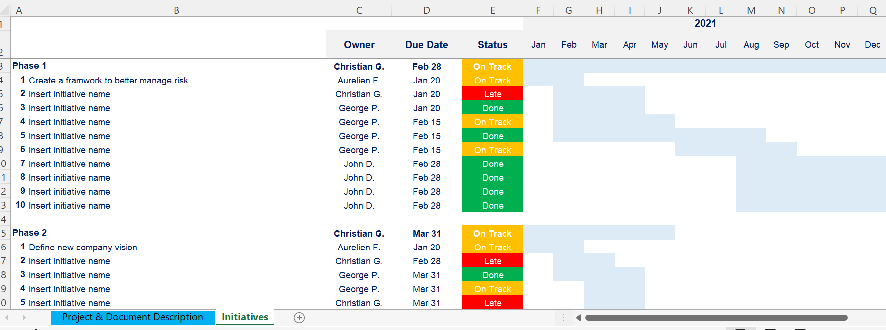
Detailed Roadmap in Excel You’ll see below a screenshot of our detailed initiatives plan. For more details, open the excel document “Detailed initiatives plan”
Additional template you may prefer to use

Slide 49
Table of contents
1.Risk Management Strategy & Plan
2.Risk Identification
3.Risk Assessment
4.Risk Prioritization
5.Risk Mitigation
6.Risk Closure and Issue Escalation
7. Issue Management
Summary of the corporate and business strategy
Risk appetite
Risk management capability maturity model
Risk management mission, vision and strategic objectives
Risk management KPIs, targets and initiatives
Roadmap to reach our strategic objectives
Risk management team and budget
Governance structure
Guiding principles
Framework to manage risk
Risk types and examples
Tools to identify risks
Simple risk log in Powerpoint
Comprehensive risk log in Excel
Probability of the risk to happen
Potential impact of the risk
Risk value
3 by 3 risk prioritization matrix in Powerpoint and Excel
5 by 5 risk prioritization matrix in Powerpoint and Excel
Response options
Examples
Actions, deadlines and responsibilities
Dashboard
Risk closure
Issue escalation
Simple issue log in Powerpoint
Comprehensive issue log in Excel

Slide 50
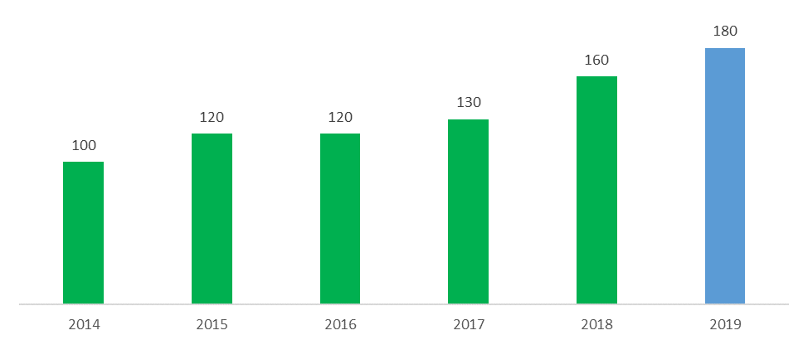
Risk Management Team Headcount Our Risk Management team will include 180 [insert your own number] people in 2022 [insert your own year]
Risk Management Team Headcount
Past & Projection

Slide 51
Risk Management Team Headcount Our Risk Management team will include 180 [insert your own number] people in 2022 [insert your own year]
Tutorial
Risk Management Team Headcount
Past & Projection
To edit this chart & table:
1.Open the excel sheet “Risk Management Team and Budget”
2.Edit
3.Copy paste the updated chart and table in this slide as an image

Slide 52
Risk Management Team Structure Our structure will include 3 [insert your own number] layers .
Insert Name
Risk Management Officer
Insert Name
Insert Role
Insert Name
Insert Role
Insert Name
Insert Role
Insert Name
Insert Role
Insert Name
Insert Role
Insert Name
Insert Role
Insert Name
Insert Role
Insert Name
Insert Role

Slide 53
Risk Management Team Structure Our structure will include 3 [insert your own number] layers .
Additional template you may prefer to use
Insert Name
Risk Management Officer
Insert Name
Insert Role
Insert Name
Insert Role
Insert Name
Insert Role
Insert Name
Insert Role
Insert Name
Insert Role
Insert Name
Insert Role
Insert Name
Insert Role
Insert Name
Insert Role
Insert Name
Insert Role
Insert Name
Insert Role
Insert Name
Insert Role
Insert Name
Insert Role

Slide 54
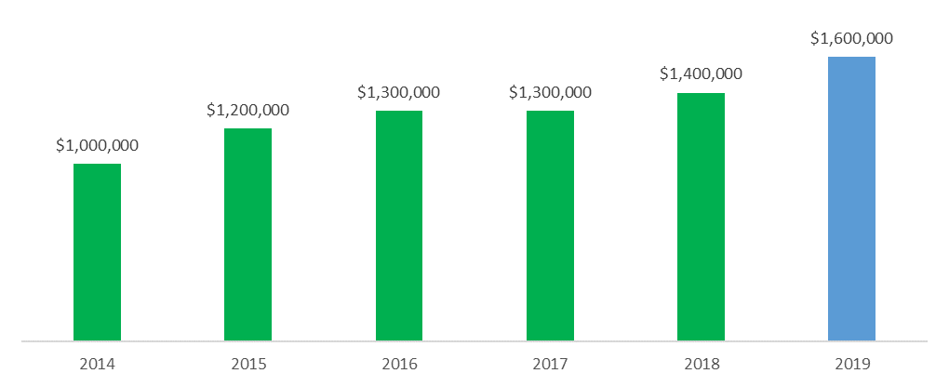
Risk Management Team Budget Our Risk Management team will be $1.6M [insert your own number] in 2022 [insert your own year]
Risk Management Team Budget (US$)
Past & Projection

Slide 55
Risk Management Team Budget Our Risk Management team will be $1.6M [insert your own number] in 2022 [insert your own year]
Tutorial
Risk Management Team Budget (US$)
Past & Projection
To edit this chart & table:
1.Open the excel sheet “Risk Management Team and Budget”
2.Edit
3.Copy paste the updated chart and table in this slide as an image

Slide 56
Table of contents
1.Risk Management Strategy & Plan
2.Risk Identification
3.Risk Assessment
4.Risk Prioritization
5.Risk Mitigation
6.Risk Closure and Issue Escalation
7. Issue Management
Summary of the corporate and business strategy
Risk appetite
Risk management capability maturity model
Risk management mission, vision and strategic objectives
Risk management KPIs, targets and initiatives
Roadmap to reach our strategic objectives
Risk management team and budget
Governance structure
Guiding principles
Framework to manage risk
Risk types and examples
Tools to identify risks
Simple risk log in Powerpoint
Comprehensive risk log in Excel
Probability of the risk to happen
Potential impact of the risk
Risk value
3 by 3 risk prioritization matrix in Powerpoint and Excel
5 by 5 risk prioritization matrix in Powerpoint and Excel
Response options
Examples
Actions, deadlines and responsibilities
Dashboard
Risk closure
Issue escalation
Simple issue log in Powerpoint
Comprehensive issue log in Excel

Slide 57
Risk Management governance structure Introduction
Our organisation’s ability to conduct effective risk management is dependent upon having an appropriate risk governance structure and well-defined roles and responsibilities.
It is important for everyone to be aware of his or her individual and collective risk management responsibilities. For risks to be effectively managed, it is essential to have people behaving in a way that is consistent with the organisation’s approved approach. This indicates that risk management is not merely about having a well-defined process but also about implementing the behavioural change necessary for risk management to be embedded in all organisational activities.
The risk management governance structure presented in the next slide illustrates that risk management is not the sole responsibility of one individual but rather occurs and is supported at all organisational levels.

Slide 58
Risk Management governance structure Organigram
Board
Provide oversight.
Review key risks.
CEO
Approve and sponsor the risk management strategy, framework and culture.
Review key risks.
Chief Risk Officer and its team
Define the risk management strategy, framework and culture using an inclusive approach.
Ensure implementation of the risk management strategy, framework and culture throughout the organization.
Risk Committee
Endorse the risk management strategy, framework and culture.
Review risk status.
Leadership and Management Team
Support the risk management strategy, framework and culture.
Identify & manage risks
Staff and contractors
Apply the risk management strategy and framework and adopt the culture.
Identify risks.

Slide 59
Risk Management governance structure Organigram
Tutorial
Board
Provide oversight.
Review key risks.
CEO
Approve and sponsor the risk management strategy, framework and culture.
Review key risks.
Chief Risk Officer and its team
Define the risk management strategy, framework and culture using an inclusive approach.
Ensure implementation of the risk management strategy, framework and culture throughout the organization.
Risk Committee
Endorse the risk management strategy, framework and culture.
Review risk status.
Of course, you may want to adjust this governance structure based on the specificities of your organization.
Leadership and Management Team
Support the risk management strategy, framework and culture.
Identify & manage risks
Staff and contractors
Apply the risk management strategy and framework and adopt the culture.
Identify risks.

Slide 60
Table of contents
1.Risk Management Strategy & Plan
2.Risk Identification
3.Risk Assessment
4.Risk Prioritization
5.Risk Mitigation
6.Risk Closure and Issue Escalation
7. Issue Management
Summary of the corporate and business strategy
Risk appetite
Risk management capability maturity model
Risk management mission, vision and strategic objectives
Risk management KPIs, targets and initiatives
Roadmap to reach our strategic objectives
Risk management team and budget
Governance structure
Guiding principles
Framework to manage risk
Risk types and examples
Tools to identify risks
Simple risk log in Powerpoint
Comprehensive risk log in Excel
Probability of the risk to happen
Potential impact of the risk
Risk value
3 by 3 risk prioritization matrix in Powerpoint and Excel
5 by 5 risk prioritization matrix in Powerpoint and Excel
Response options
Examples
Actions, deadlines and responsibilities
Dashboard
Risk closure
Issue escalation
Simple issue log in Powerpoint
Comprehensive issue log in Excel

Slide 61
Risk management guiding principles
1
Insert your own guiding principle
2
Insert your own guiding principle
3
Insert your own guiding principle
4
Insert your own guiding principle
5
Insert your own guiding principle
6
Insert your own guiding principle

Slide 62
Risk management guiding principles
Real-life example from a Fortune 1000 company
1
Ensure alignment between the risk management strategy and the corporate and business strategy
2
Involve stakeholders
3
Manage risk within context
4
Ensure risks are identified early
5
Ensure responsibilities and roles are clear
6
Strive for continuous improvement

Slide 63
Risk management guiding principles
Real-life example from a Fortune 1000 company
1
Good governance and leadership are critical to ensure effective risk management throughout the organization
2
An inclusive approach to define the risk management strategy helps to achieve necessary buy-in across the organization
3
A common language surrounding risk management must be established to unify and standardize risk management across the organization
4
Pragmatism is key in developing and refining our risk management framework
5
Risk must be embedded in decision-making processes
6
Risk management is a journey

Slide 64
Table of contents
1.Risk Management Strategy & Plan
2.Risk Identification
3.Risk Assessment
4.Risk Prioritization
5.Risk Mitigation
6.Risk Closure and Issue Escalation
7. Issue Management
Summary of the corporate and business strategy
Risk appetite
Risk management capability maturity model
Risk management mission, vision and strategic objectives
Risk management KPIs, targets and initiatives
Roadmap to reach our strategic objectives
Risk management team and budget
Governance structure
Guiding principles
Framework to manage risk
Risk types and examples
Tools to identify risks
Simple risk log in Powerpoint
Comprehensive risk log in Excel
Probability of the risk to happen
Potential impact of the risk
Risk value
3 by 3 risk prioritization matrix in Powerpoint and Excel
5 by 5 risk prioritization matrix in Powerpoint and Excel
Response options
Examples
Actions, deadlines and responsibilities
Dashboard
Risk closure
Issue escalation
Simple issue log in Powerpoint
Comprehensive issue log in Excel

Slide 65







Framework to manage risk
Practical Framework to Manage Risk
1.Risk Management Strategy & Plan
2.Risk Identification
3.Risk Assessment
4.Risk Prioritization
5.Risk Mitigation
6.Risk Closure and Issue Escalation
7. Issue Management
This approach is simple and straightforward, which makes its implementation easy for everyone within your organization. For more details, open the document “Risk Management Framework”

Slide 66
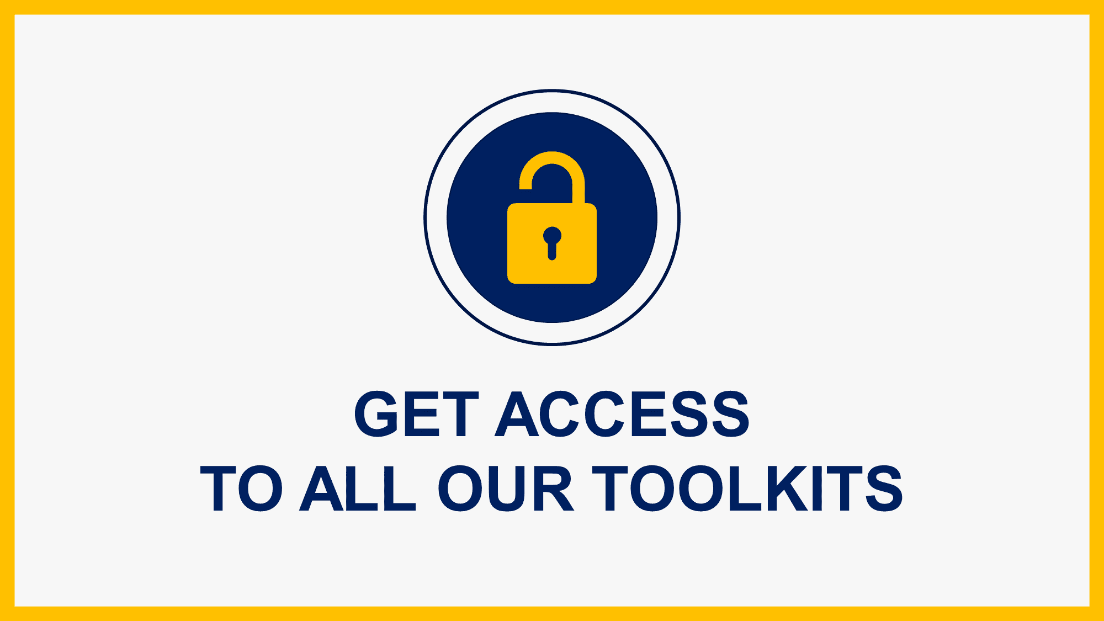
Interested in more than 1 Toolkit? Access all our Toolkits for half the price with our Gold Access
Gold Access
Click here to learn more

Slide 67
Thanks for your attention!
www.domontconsulting.com

